Slide 1
Blowfish – symmetric key cryptosystem
Characteristics of blowfish
Fast – encrypts data very fast on 32-bit CPUs
compact - uses less memory, <5K memory
Simple – has simple structure – easy to implement & easy to analyse.
Variably secure – has variable length key size up to 448 bits

Slide 2
Blowfish Key & subkey
uses a 32 to 448 bits key
Key size will be multiple of 32
Key bits are stored in array : k1 …k j, 1<=j<=14
Each of k1 …kj stores 32 bits of key sequentially
Subkeys(round keys)
There are 18 subkeys. Each subkey is of size:32 bits
subkeys are stored in array: P_{1,} …, P₁₈

Slide 3
S-boxes
There are four S-boxes: S1,j; S2,j; S3,j; S4;j; 0<=j<=255
Each S-box has 256 entries
Each entry in S-box is of size: 32 bits
S1,0 S1,1 ….S1,255
S2,0 S2,1 ….S2,255
S3,0 S3,1 ….S3,255
S4,0 S4,1 …. S4,255

Slide 4
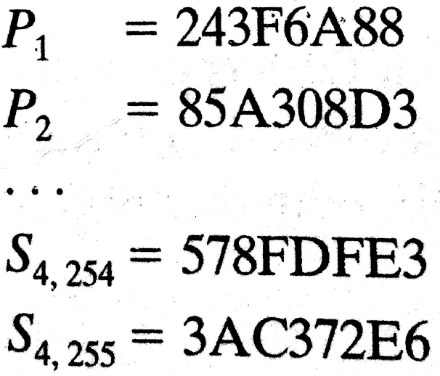
Generation of subkeys and S-boxes
Step1. Initialise subkey P arrays and S-box entries using bits of fractional part of ‘pi’ as follows (given in hexadecimal)

Slide 5
Step2. XOR P-array (sub key bits) with K-array (key bits), (reuse K-array as needed).
Eg., If key has 448 bits stored in K1, …, K14,
Then update subkeys as:
P1=P1 XOR K1, …,
P14=P14 XOR K14,
P15=P15 XOR K1, …,
P18 XOR K4.

Slide 6
Step 3. Encrypt 64 bits of “zeros” with current values of P and K –arrays. Assign the output (ciphertext) to P1,P2
Step 4. Encrypt P1||P2 with current values of P and K –arrays. Assign the output (ciphertext) to P3,P4
Step 5. Continue this process to update all elements of P and then S boxes.

Slide 7
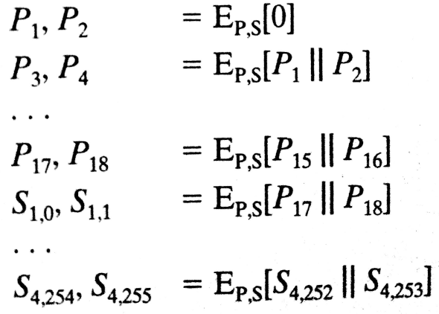

Slide 8
521 encryptions are required to generate sub keys and S-boxes.
So blowfish is not suitable for applications where keys are frequently changed
For fast encryption of message, we have to store the subkeys and S-boxes in memory instead of generating every time. This requires 4 kBytes and hence it is not suitable for applications with limited memory , like smart cards

Slide 9
Blowfish Encryption
uses two operations: addition (+ % 2^32) & XOR
data is divided into two 32-bit halves L₀ & R₀
for i = 1 to 16 do
R_{i} = L_{i-1} XOR P_{i};
L_{i} = F[R_{i}] XOR R_{i-1};
L₁₇ = R₁₆ XOR P₁₈;
R₁₇ = L₁₆ XOR P₁₇;
where
F[a,b,c,d] = ((S_{1,a} + S_{2,b}) XOR S_{3,c}) + S_{4,d}

Slide 10
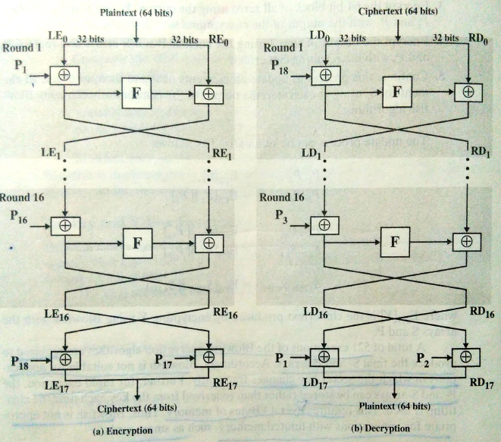

Slide 11
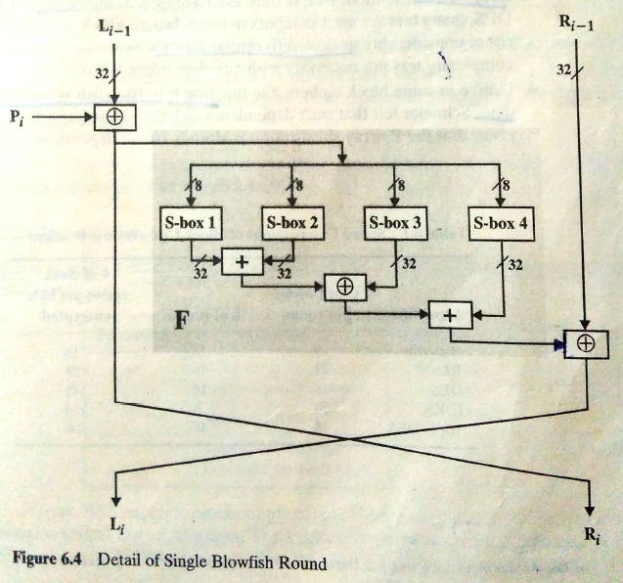

Slide 12
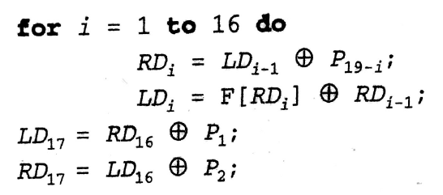
Blowfish Decryption
Use same algorithm with keys in the reverse order.

Slide 13
Strength of Blowfish
Brute force attack is infeasible due to variable and large size of keys
522 executions are required to check correctness of a single key.
Round function provides good avalanche effect.
Invulnerable to differential attacks due to the design of S-boxes.

Slide 14
